Slide 1
“I don’t want to get my copyright stripped off”
Michael Steidl, IPTC @JPEG Privacy & Security Workshop
13 October 2015, Brussels (Belgium)

Slide 2
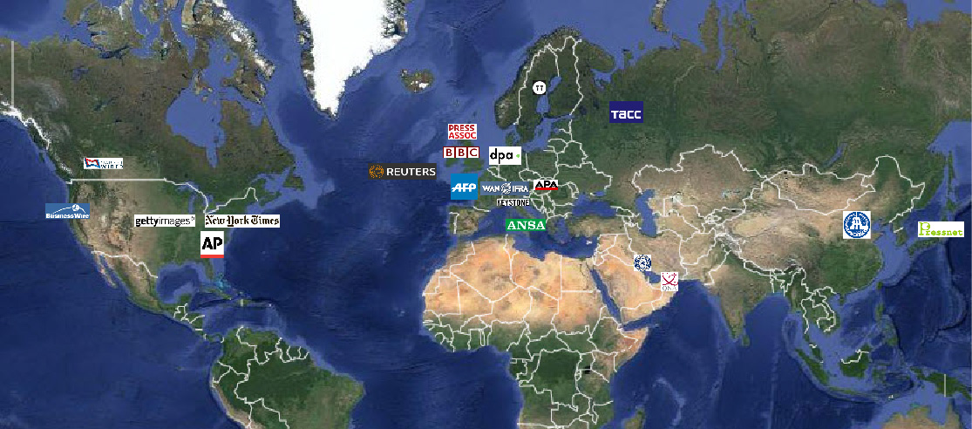
IPTC – who‘s that?
The global standards body for the news media
A not-for-profit organisation with more than 50 members
… from news agencies, newspapers, broadcasters and systems vendors
… only a subset of members is shown

Slide 3
IPTC Photo Metadata Standard
… defines a schema of metadata properties
… by 3 major groups:
Describes what can be seen in an image: caption, persons, locations, artwork, products …
Writes down administrative data: when created, identifier(s), job id, instructions …
Defines data relevant for rights: creator, copyright owner, licenses, credit line, model release, property release …

Slide 4
Photo workflow/supply chain
Photog takes photo, initial metadata (e.g. creator + copyright + who is shown)
Photo library in country ABC: gets local copyright, modifies metadata (e.g. adds location …)
International photo agency EPA: gets international copyright, modifies metadata
Online news XYZ in country KLM: publishes the photo on their website. May modify metadata.
Mary Miller: sees photo, likes it, downloads it, cannot get aware of a copyright and shares the photo by Pinterest

Slide 5
The Challenge
Looking at the photo downloaded by Mary Miller, a party from the supply chain may shout: “I don’t want to get my copyright stripped off”

Slide 6
The Real Challenge
How to guarantee that Mary Miller has the correct metadata in the image file

Slide 7
Clarification
IPTC
… has as long experience and strong knowledge about the data used to describe and manage a photo …
… but only little knowledge about how to secure metadata against modifications without permission.
We want to forward the needs of people using the IPTC metadata schema to security experts.

Slide 8
What needs to be secured
IPTC sees the need for different levels of protection
"never ever change the value of property X“ (after the initial application of the value)
"property Y may be changed only with an agreement by the prior editor of this property value"
Protected history of changes which allows to track back

Slide 9
Limit editing metadata
Top Level „never ever change“
E.g. Initial Globally Unique Identifier
Second Level: change only with an explicit permission by the last editor of this value (maybe: using a shared key)
Creator
Core rights properties: Copyright Owner + Notice, Licensing
Third Level: at least show a warning and keep records (history) of any change
Model & Property Releases
Credit Line

Slide 10
Control editing metadata
IPTC‘s wish-list:
Each (protected) metadata field should get a security level assigned
Editing a metadata field should only be possible with a permission of the previous editor of the metadata values – depending on the security level.

Slide 11
Show alarm if a change was not permitted
IPTC knows: as long as bits and bytes of a file can be changed also the bits and bytes of embedded metadata can be changed.
Sealing metadata does not protect it against changing its bytes but a modification can be detected!
IPTC’s wish: if sealed metadata have been changed an alarm should be shown to the user. The user has to draw conclusions.

Slide 12
Implementation
IPTC‘s wish-list:
The security features should be implemented by a widely supported standard/technology.
The implementation should be a planned joint action of standardization bodies and software implementers. (To overcome the usual chicken-egg business discussion: what’s first, the need for that feature or the software providing the feature.)

Slide 13
Thank you for listening to IPTC.
We are happy to join a discussion of next steps.
Meet IPTC at www.iptc.org/photometadata

