Slide 1
Privacy-Preserving Photo Sharing based on Secure JPEG
Lin Yuan, Touradj Ebrahimi
Multimedia Signal Processing Group, EPFL
Notes:
A solution to protecting privacy in photo sharing

Slide 2
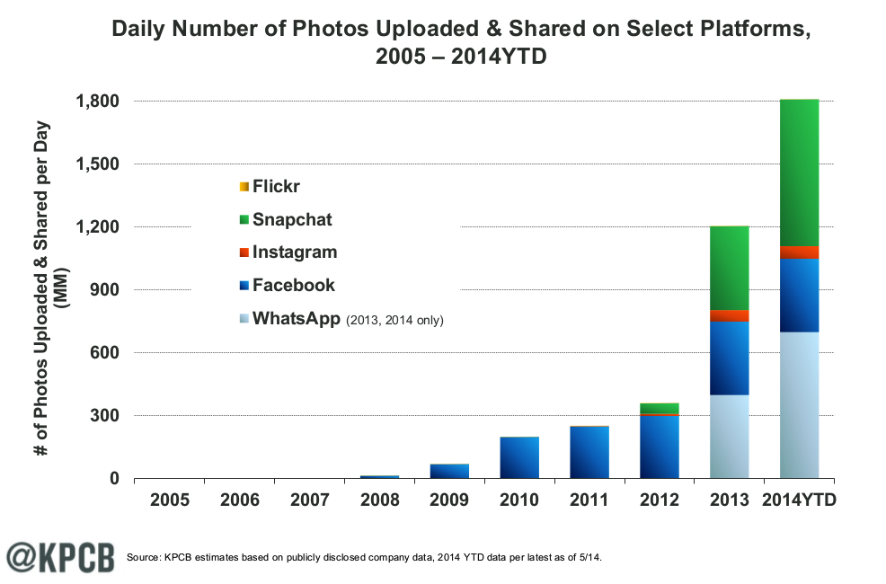
Motivation
Social network and cloud service
Easy and fast photo sharing,huge amount
Privacy concern:
  “A picture is worth a thousand words.”
  Visual info., metadata, geo-taging, etc.
Notes:
OSN creates a lot of privacy issues. Especially for multimedia content like images and videos. As these kinds of content convey a great amount of information.

Slide 3

Motivation
Privacy scandals
  Governmental surveillance, e.g. PRISM
  Leakage of celebrities private photos
Existing privacy protection solutions
  limited degree of protection and control

Slide 4
Goal and Approaches
Goal
  Ensure user defined visual privacy in online photo sharing, while preserving a maximal usability
Approaches
  Secure JPEG:
    JPEG Scrambling
    JPEG Transmorphing
  Photo sharing architecture based on a Public Key Infrastructure (PKI)

Slide 5
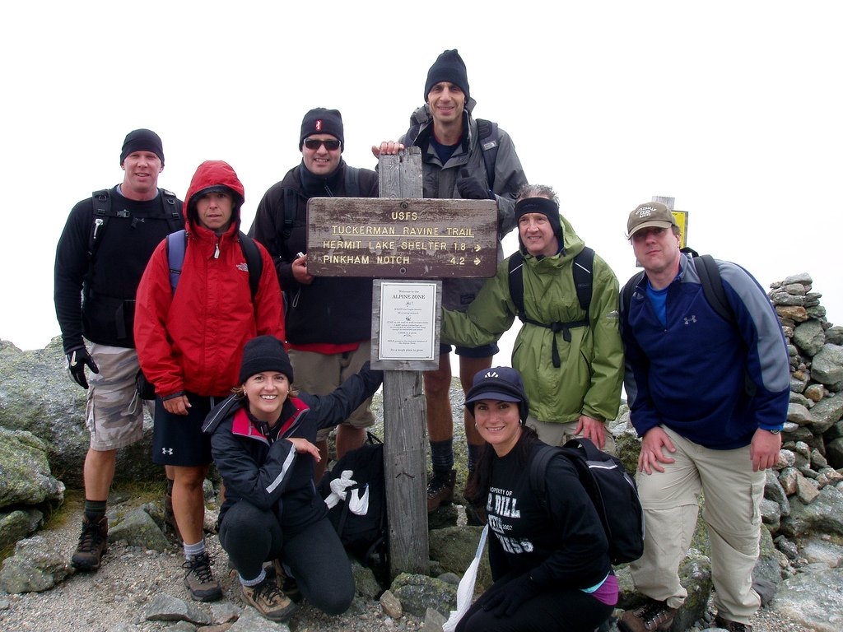
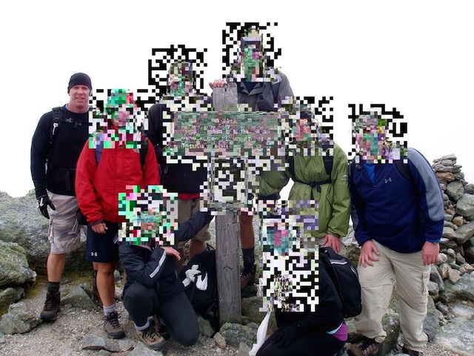
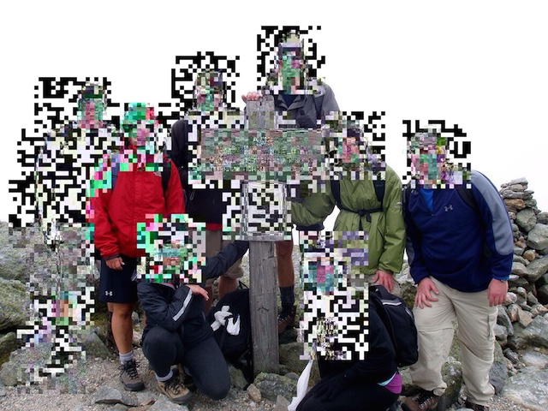
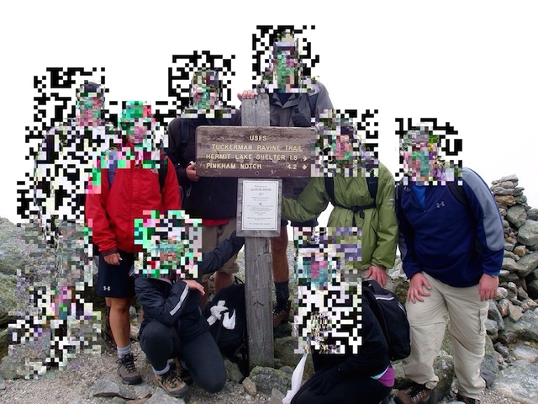
JPEG Scrambling
Randomly change the signs of DCT coefficients
Original JPEG photo
Descrambled photos
Signs of DCT coefficients
Scrambled JPEG photo
1
3
4
2
5
6
8
9
7
…
…
…
Metadata
Pseudo-random number
Insert parameters in JPEG header

Slide 6
JPEG Transmorphing
Converting an image to processed version while preserving sufficient information about the original image in the processed image.
Notes:
This method is to convert an image to its

Slide 7
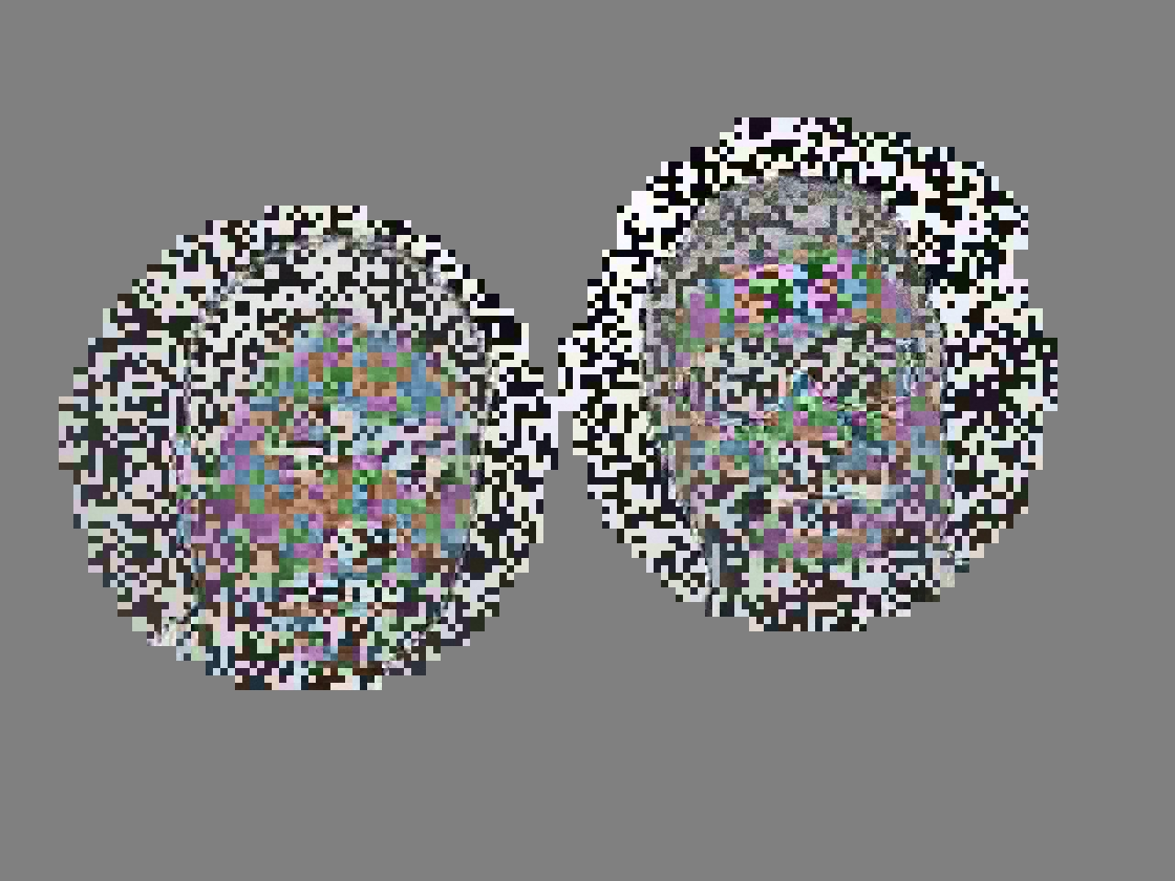

JPEG Transmorphing
APP marker in JPEG header
Protected
Sub-image
Transmorphed JPEG image
Protection method & parameters
File size in byte
0 0 0 0 0 0 0 0 0 0 0 0 0 0 0
0 0 0 0 1 1 1 1 1 1 1 0 ……
0x01 0x02 0xB7 0x1F 0x2A 0x45 0xF4 0x3C 0x6B 0xE1 0x13 ……
APP markers
Marker ID
1 byte
Security Tool
2 bytes
Mask Matrix
m bytes
Data Length
4 bytes
Sub-Image Data
n bytes
Metadata

Slide 8
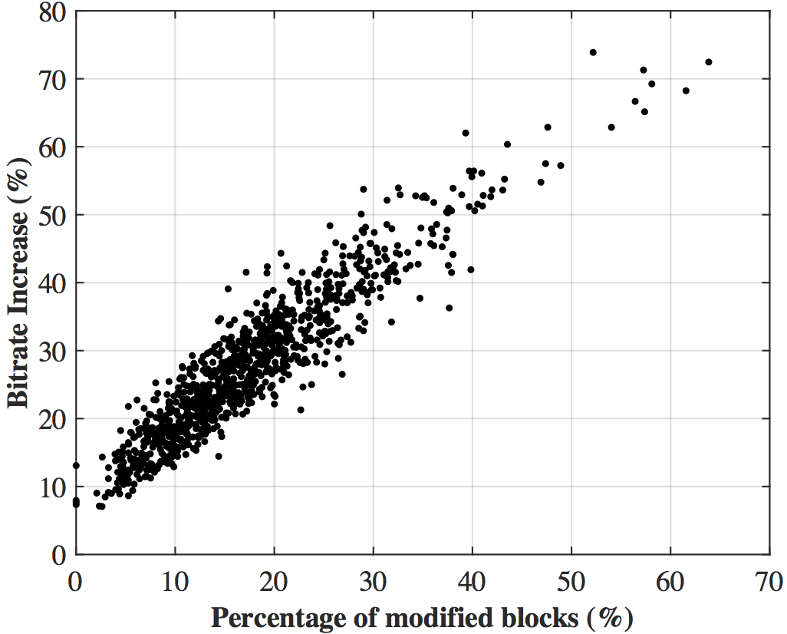
Evaluation and Comparison
Bitrate Overhead
Scrambling
Transmorphing
 | Low-level scrambled | Medium-level scrambled | High-level scrambled
AVG. overhead (face regions scrambled) | 1.87% | 2.04% | 2.15%
AVG. overhead (whole image scrambled) | 1.87% | 4.89% | 5.96%
1000 images, max. pixel resolution 1024 x 1024, file size 100 KB ~ 330 KB

Slide 9
Evaluation and Comparison
Similarity
  JPEG backward compatible
  Reversible, and fast
Difference
  Bitrate overhead
    Scrambling: extremely low
    Transmorphing: higher
  Pleasantness
    Transmorphing is absolutely better

Slide 10
Photo Sharing Architecture
Assumptions
  Client device/application completely trusted
  Server minimally trusted (for revocation)
  Social networks or cloud services not trusted
  No cache of image and key data on client device (for revocation)

Slide 11
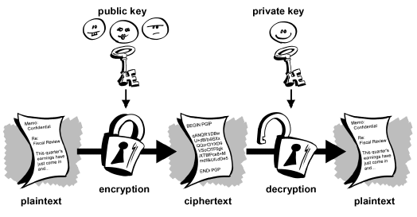
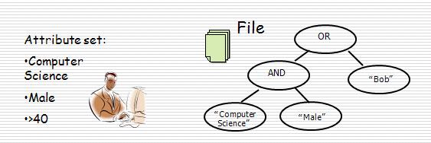


Photo Sharing Architecture
Public Key Infrastructure
  Private key cryptography
    Like our Secure JPEG protection
  Public key cryptography
    Encrypt data with public key
    Decrypt data with private key
  Ciphertext-Policy Attribute-based Encryption (CP-ABE)
    Encrypt data with an access structure (policy)
    Decrypt with a private key, associated with a set of attributes
key
key

Slide 12
Photo Sharing Architecture

Slide 13
Photo Sharing Architecture
Photo protection, sharing and accessing

Slide 14
Photo Sharing Architecture
Assign attribute privacy keys to friends

Slide 15
Photo Sharing Architecture
Revocation
  Revoke a friend Attribute Private Key
  Revoke a picture’s Access Policy

Slide 16
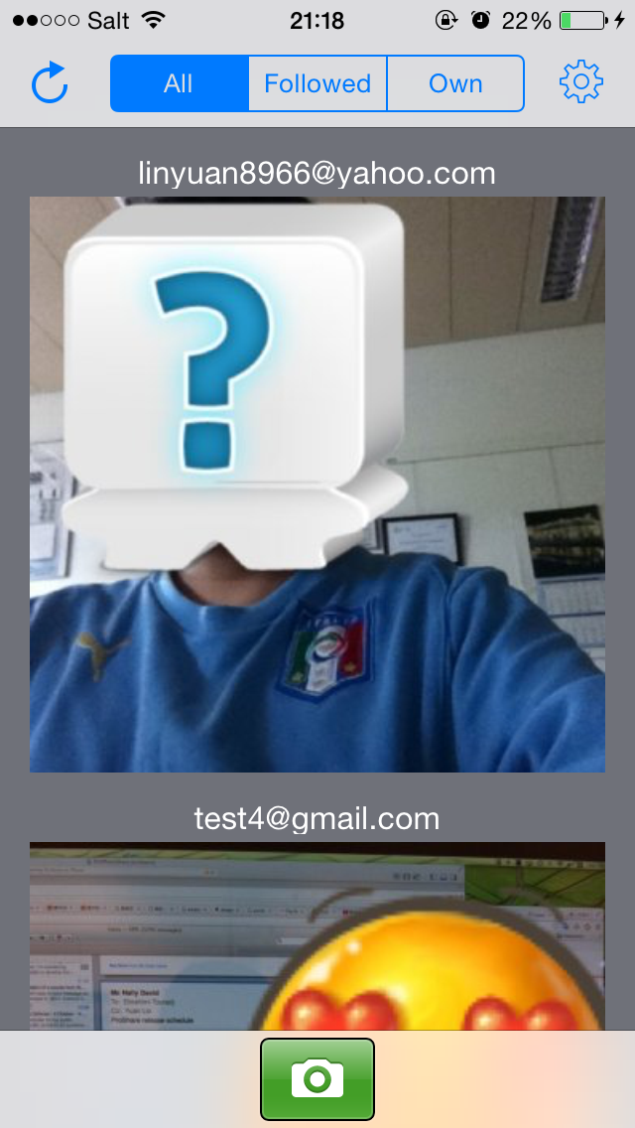
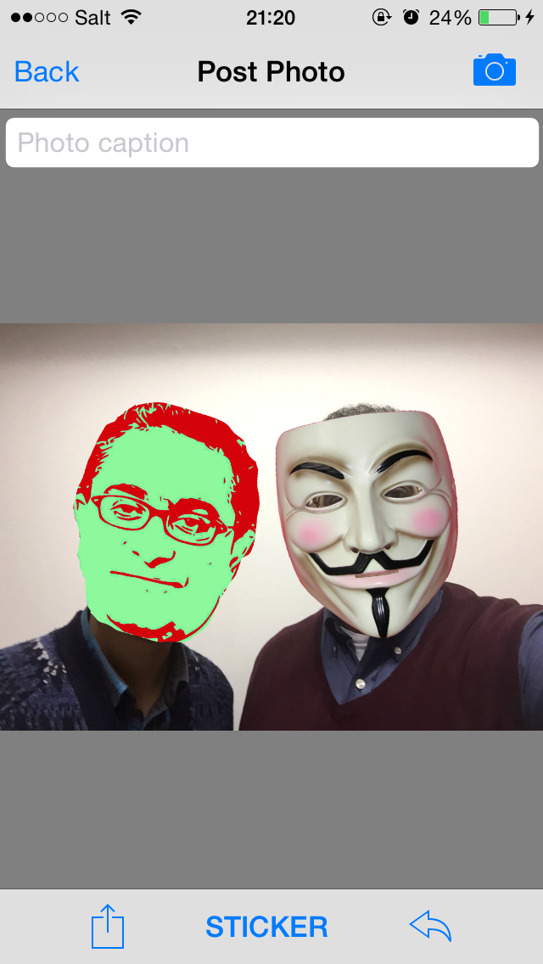
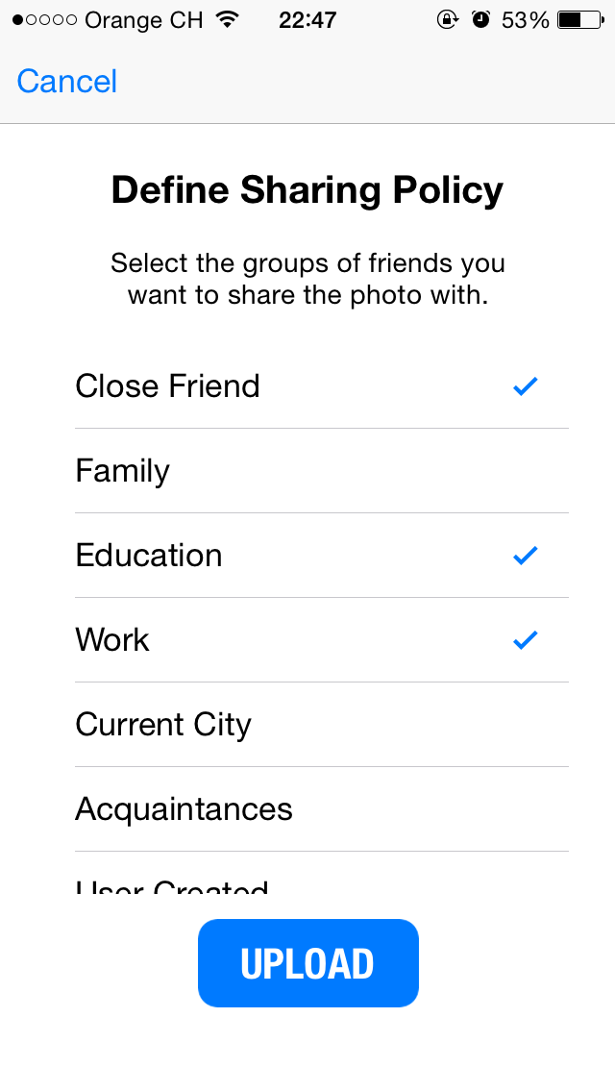

Prototype and Demo
Prototype application: ProShare
  iOS
  Android
ProShare

Slide 17
Reference
L. Yuan, P. Korshunov and T. Ebrahimi. Secure JPEG Scrambling enabling Privacy in Photo Sharing. Workshop on De-identification for privacy protection in multimedia, Ljubljana, Slovenia, 2015.
L. Yuan and T. Ebrahimi. Image Transmorphing with JPEG. IEEE International Conference on Image Processing (ICIP), Québec City, Canada, 2015.
L. Yuan, D. Mc Nally, A. Küpçü and T. Ebrahimi. Privacy-Preserving Photo Sharing based on a Public Key Infrastructure. SPIE Optical Engineering + Applications, San Diego, California, USA, Applications of Digital Image Processing XXXVIII, 2015.

Slide 18
Thanks!
Question?

