Slide 1
JPEG Privacy & Security Introduction and Scope
Prof. Touradj Ebrahimi
JPEG Convener

Slide 2
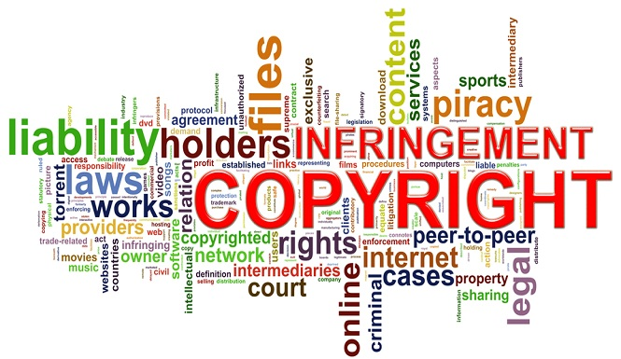
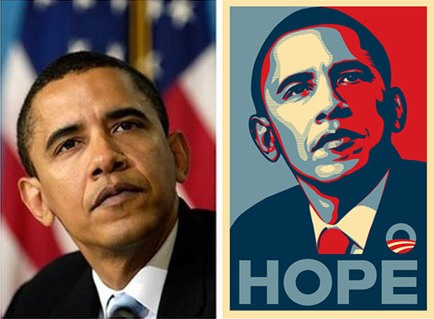
Copyright management remains an issue!

Slide 3
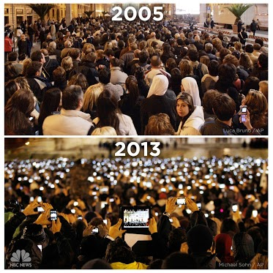
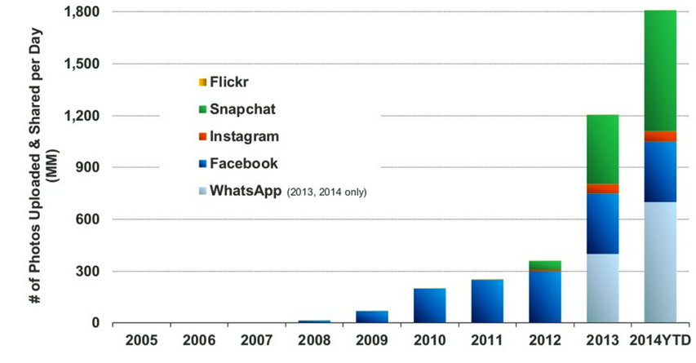
Privacy is becoming a concern!
Source: KPCB 2014 Internet Trends, estimates based on publicly disclosed company data.

Slide 4
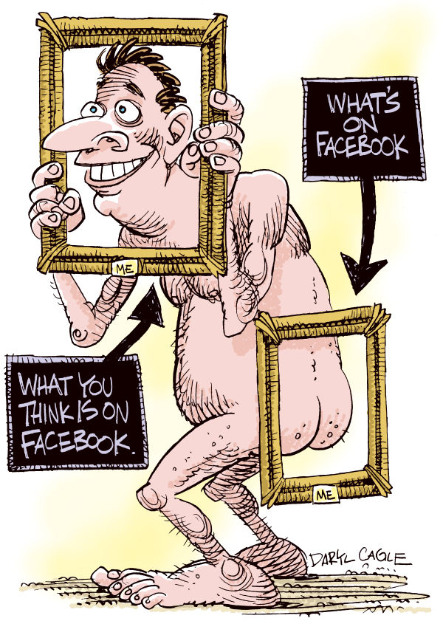
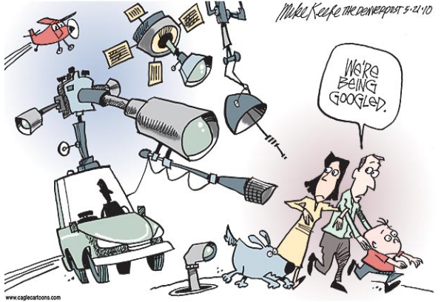
Why is privacy protection so difficult to resolve?

Slide 5
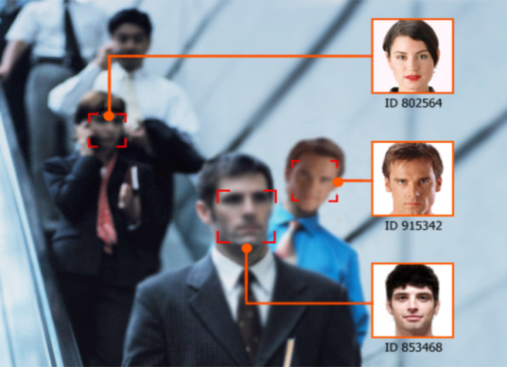
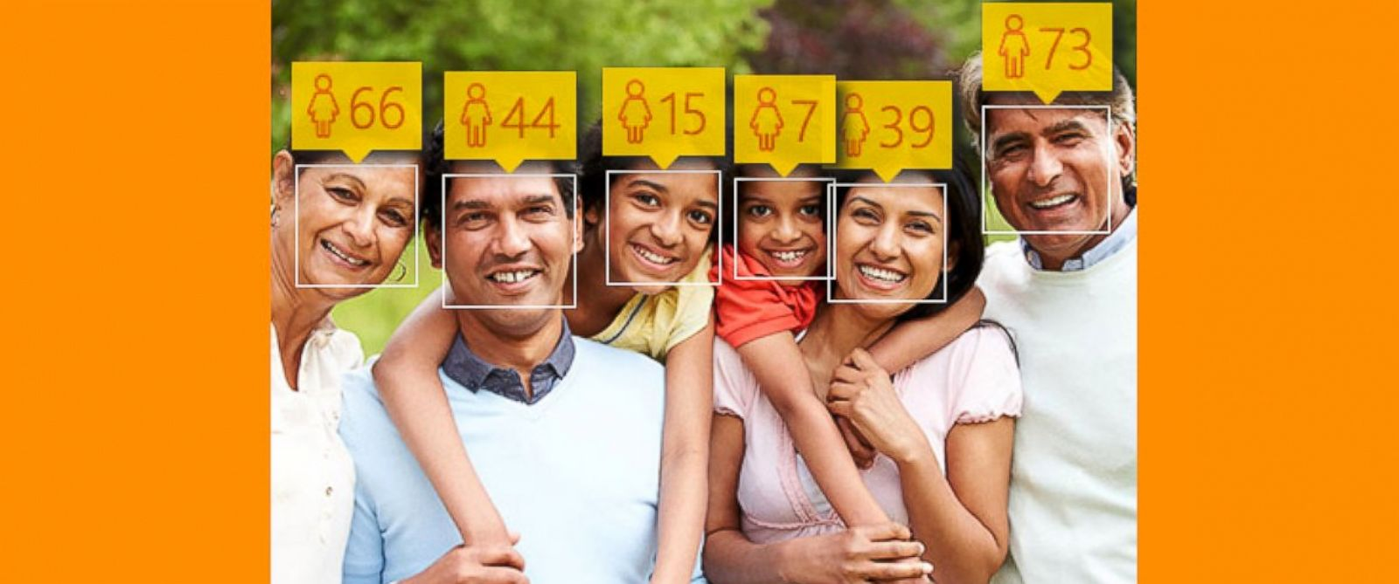
Why is privacy protection so difficult to resolve?
New technologies to better analyze, annotate, search and interpret data
Lack of awareness and education
Lack of incentives from those who can contribute to solutions

Slide 6
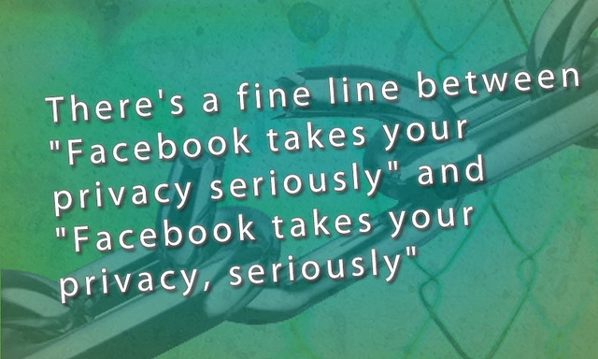
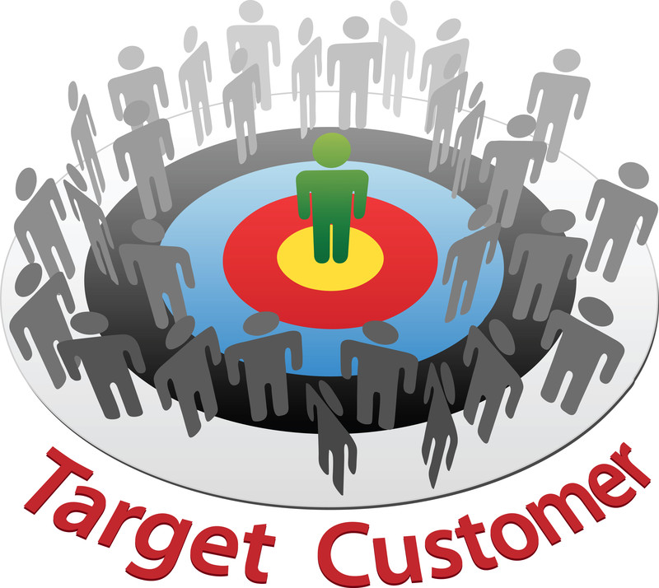
Social media/networks business model
User profiling
Targeted advertisement/marketing

Slide 7
JPSEC: Secure JPEG 2000
Confidentiality via encryption and selective encryption
Integrity verification
Source authentication
Conditional access
Registered content identification
Secure scalable streaming and secure transcoding

Slide 8
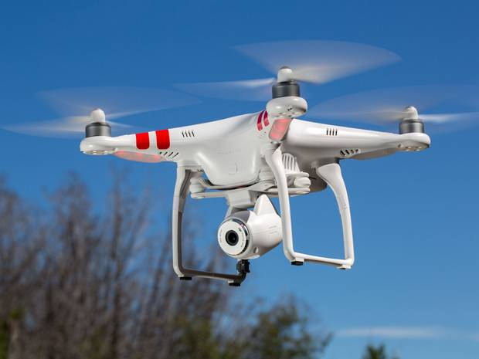
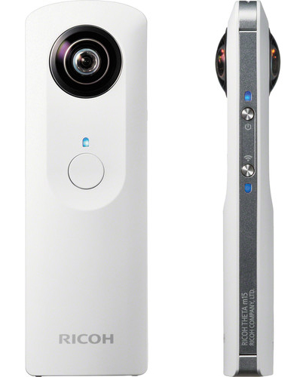
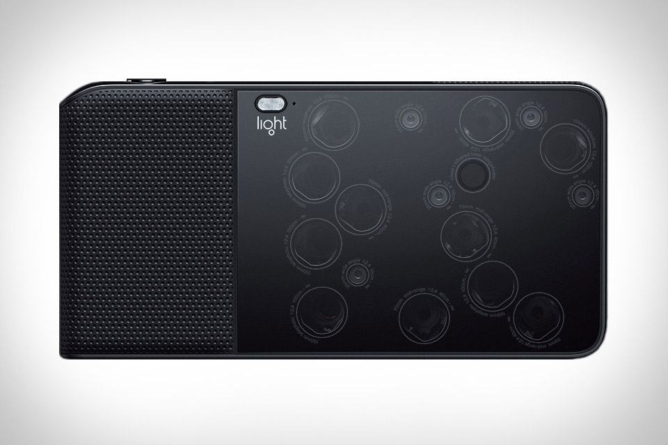
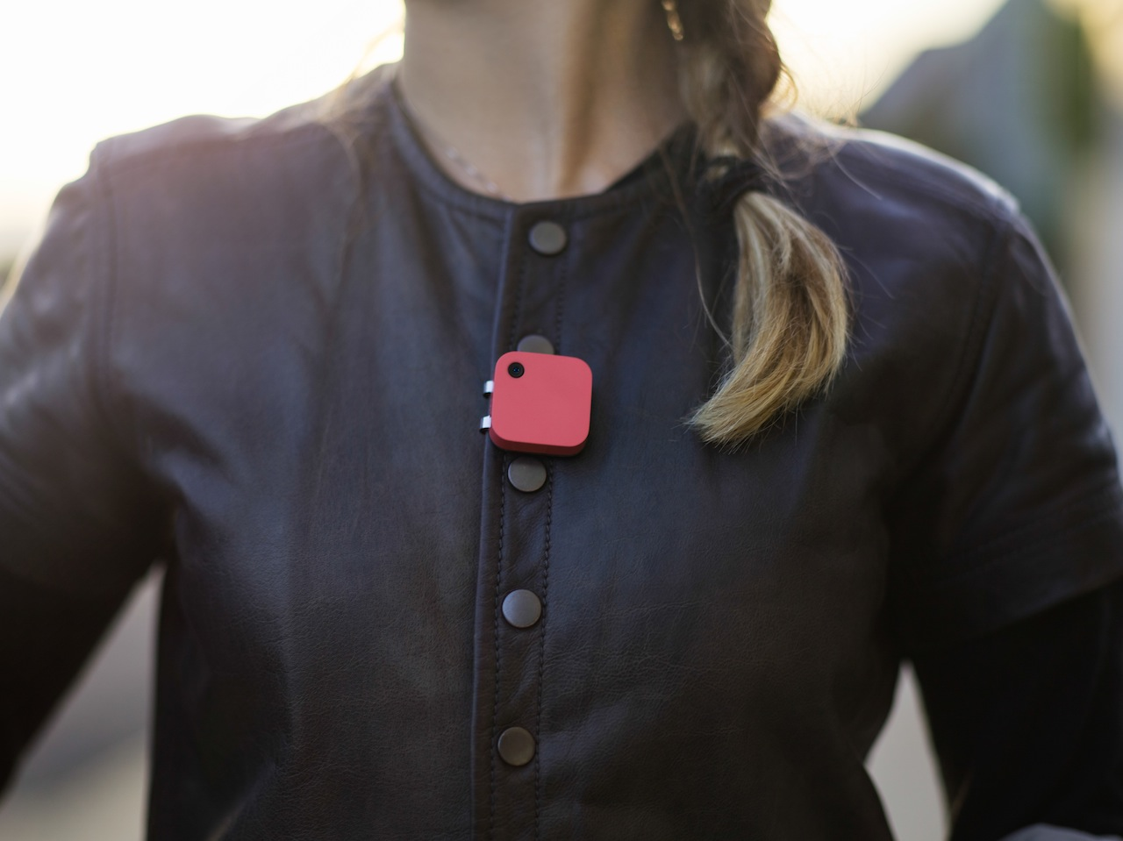
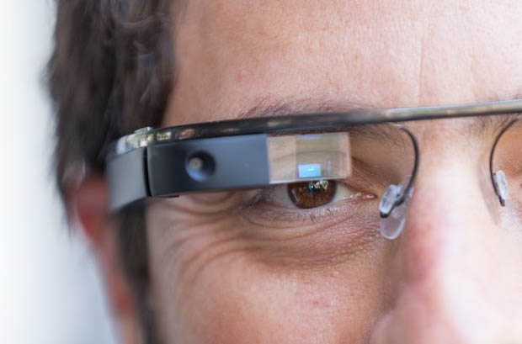
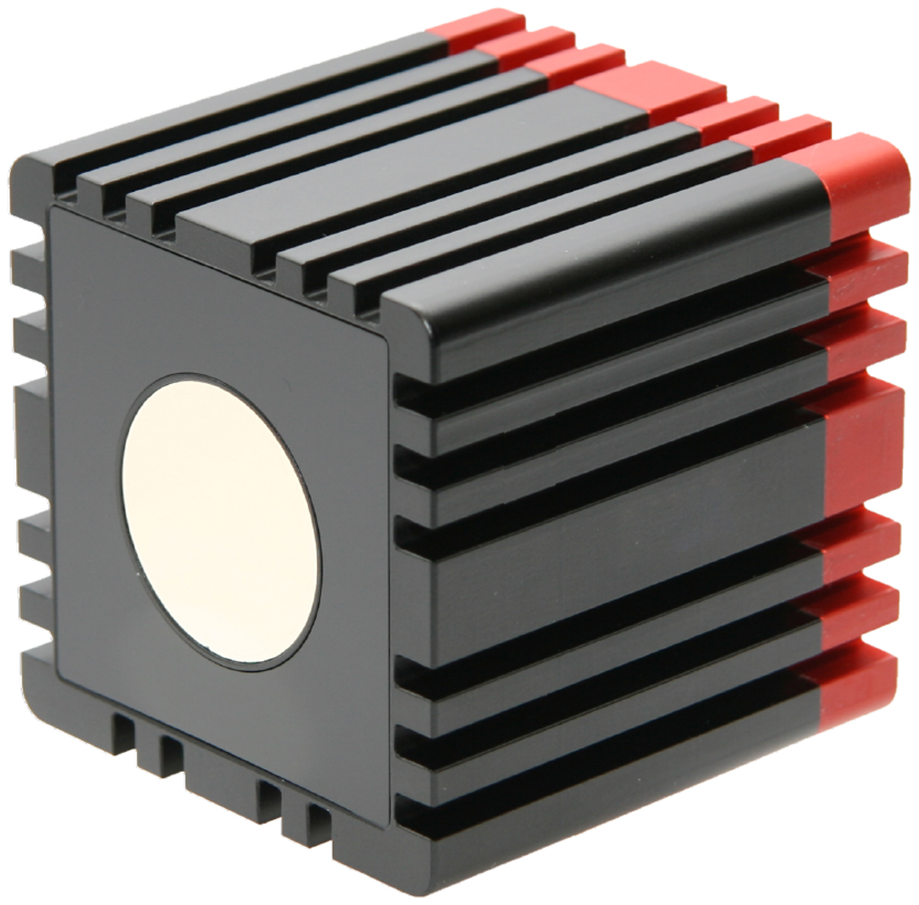
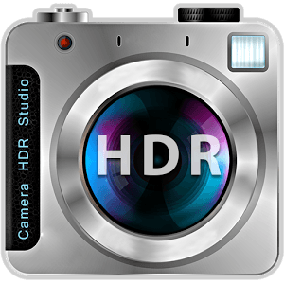
Let us not forget the future of imaging!

Slide 9
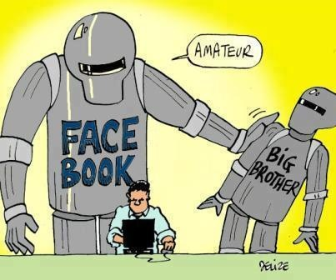
Impact of new imaging on privacy and security

Slide 10
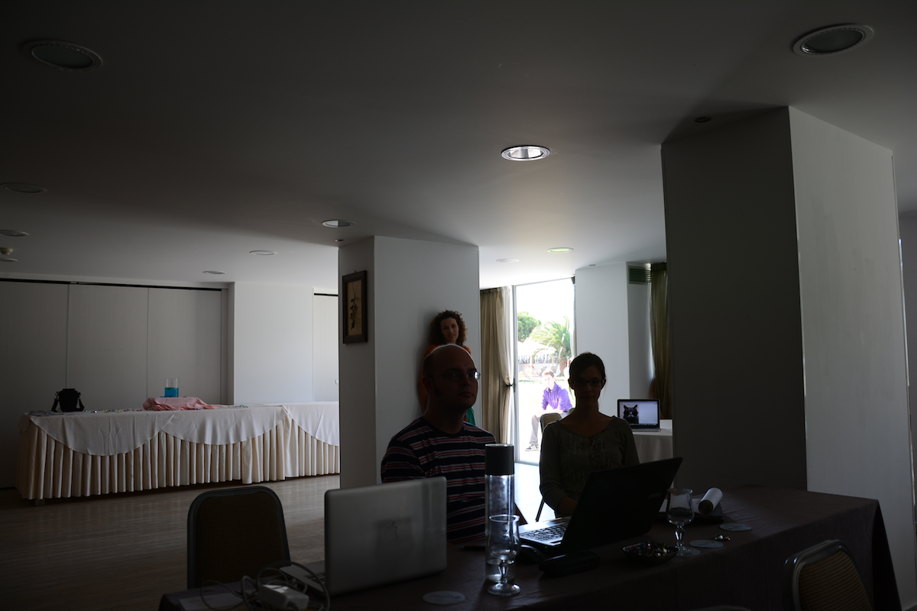
LDR image

Slide 11
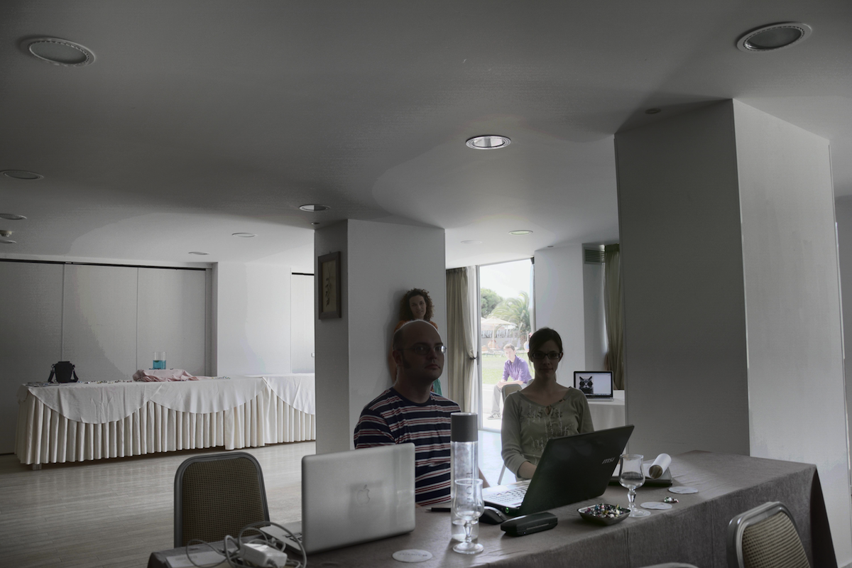
HDR image

Slide 12
JPEG Privacy & Security
SOI
SOI
APP1 (Exif)
APP1 (Exif)
APP1 (Exif)
JPEG-1 decoder
APP3 (JPSearch)
APP3 (JPSearch)
Image Data
APP11
(protected metadata)
APP1 (Exif)
Image Data
APP11
(protected
image data)
APP3 (JPSearch)
JPEG Privacy & Security
decoder
APP11
(protected metadata)
Image data
APP11
(protected
image data)
EOI
EOI
original JPEG
codestream
JPEG compatible
codestream with
data protection
Image data

Slide 13
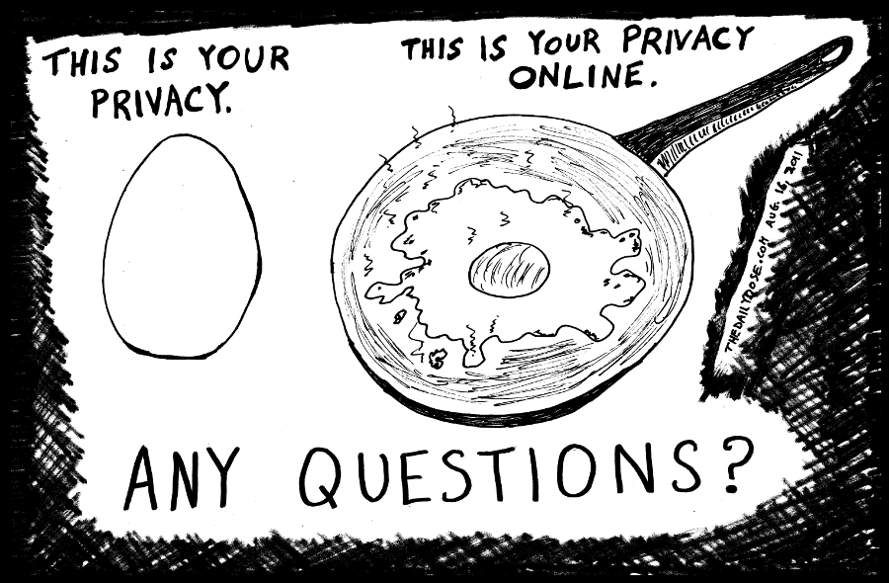
Looking forward to an exciting workshop

